Slide 1





SRNS AIRLINES APP
CMPE 202 - Sec 03
SRNS (Group 7)

Slide 2
Our Team Leads
Front End- Ramin Mousivand
Back End- Sahil Bhagchandani
DataBase- Navika Babbar
Deployment and Scrum Planner- Shervin Suresh

Slide 3



Project Overview

Slide 4
Our Application
“
Create an Airline App, where customers can easily book flights and be rewarded for their loyalty
“

Slide 5
Feature Set
Customer
Manage Mileage Rewards Account
Search for Flights
Book Seats
Change/ Cancel Reservations
Create an Account
Admin
Add New Flights
Delete Flights
Change Flights

Slide 6
Project Diagrams

Slide 7
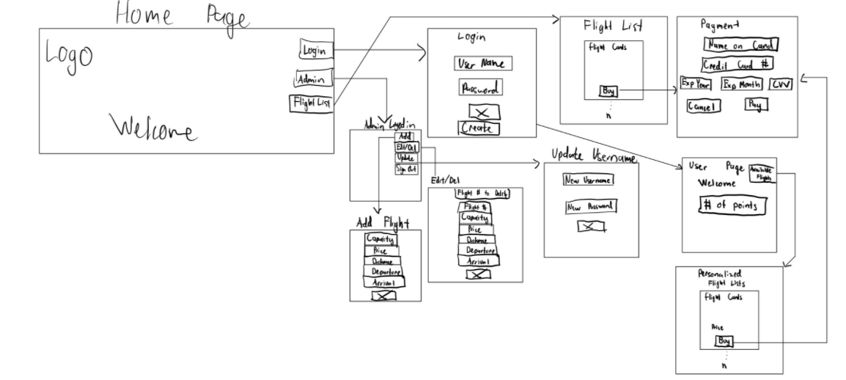
Wireframe Diagram

Slide 8
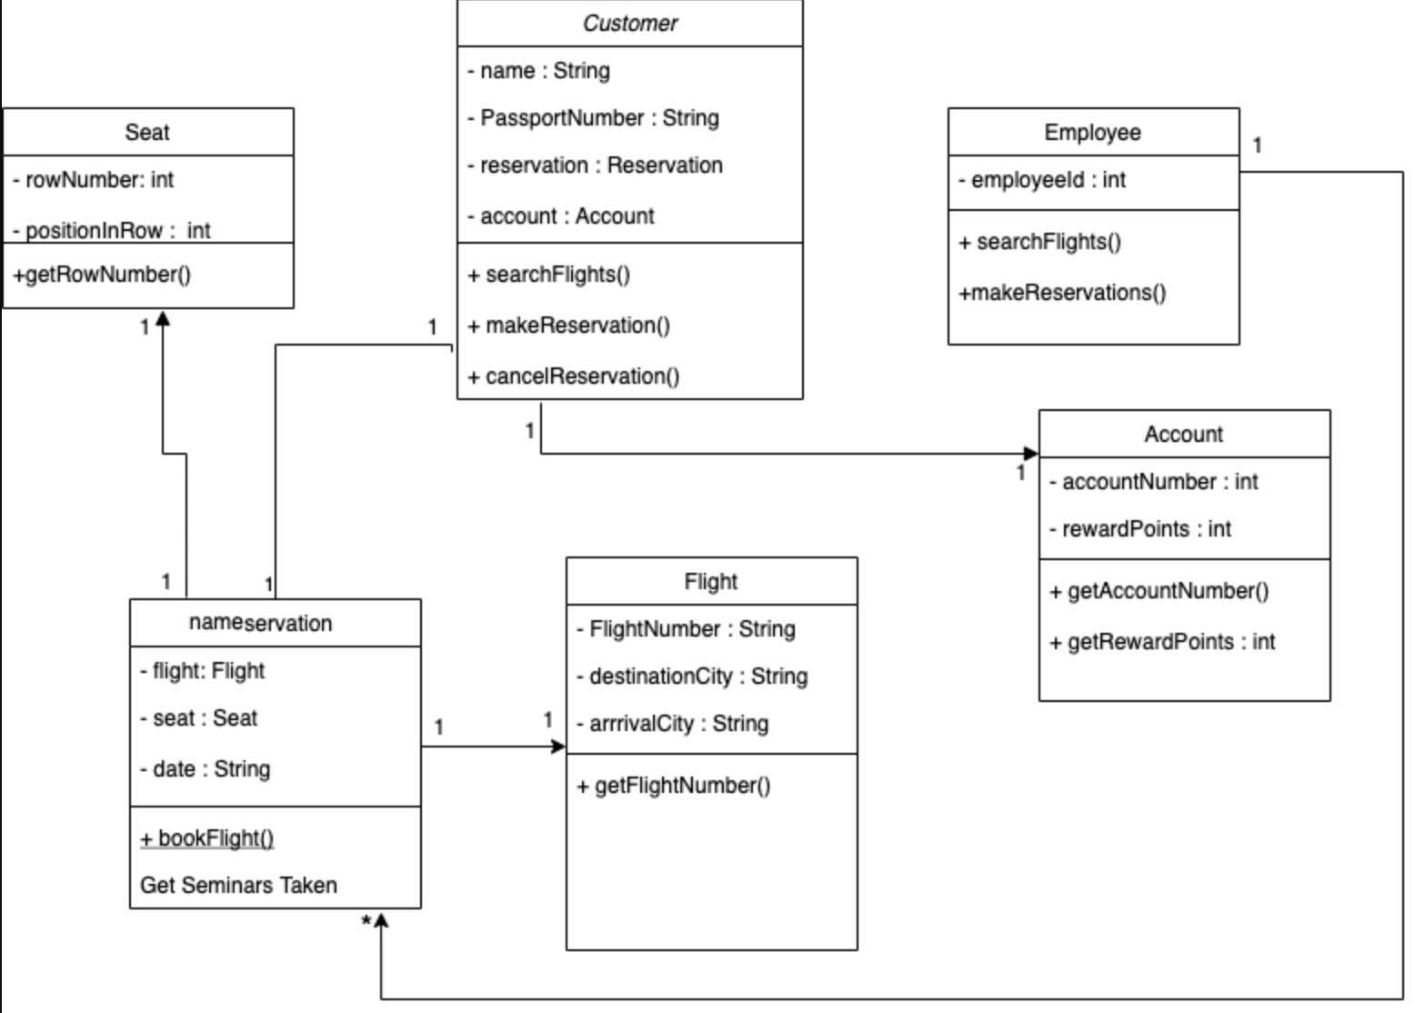
Architecture Diagram

Slide 9








Scrum Process
A walkthrough of how we planned development and creation of the application

Slide 10
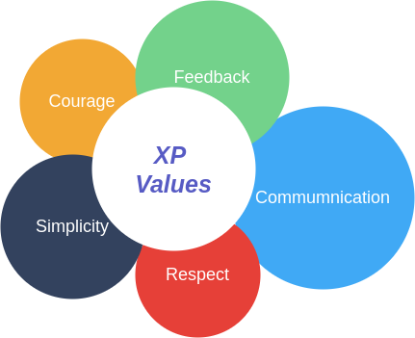
Core XP Value
RESPECT- play on each team members strengths and help each other grow in the process

Slide 11
Weekly Scrum Meetings
Planned:
Takes the to-do from the previous week
In Progress:
Throughout the week progress till the end of scrum meeting
Done:
Tasks that have been accepted as complete by the group

Slide 12
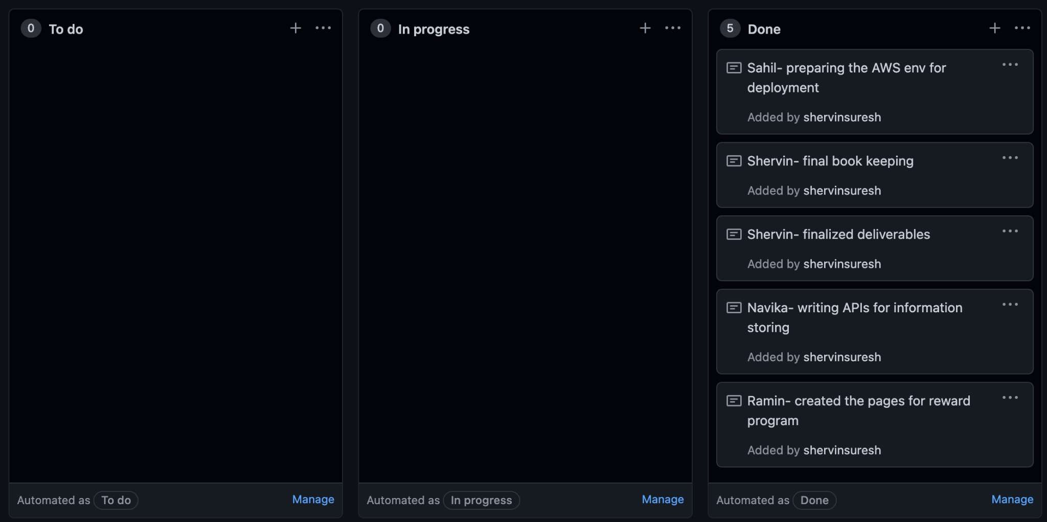
Example of Project Board

Slide 13
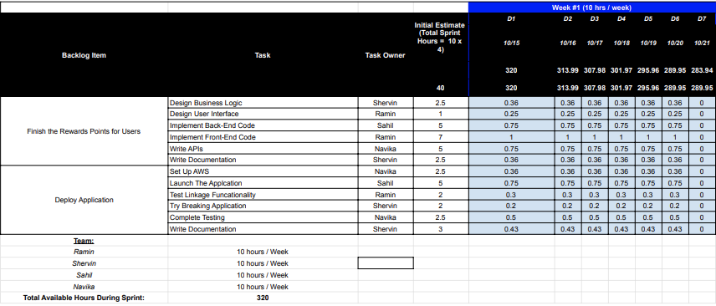
Task Sheet

Slide 14
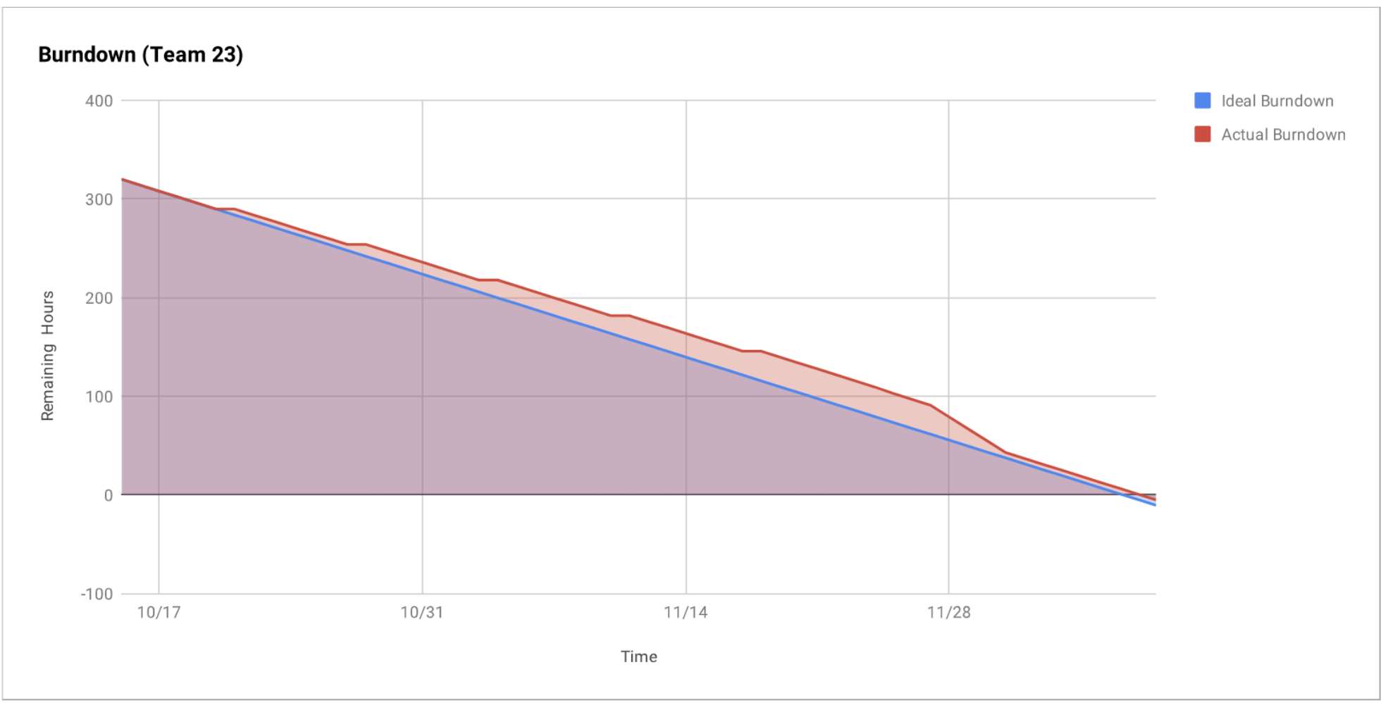
Burn Down Chart

Slide 15
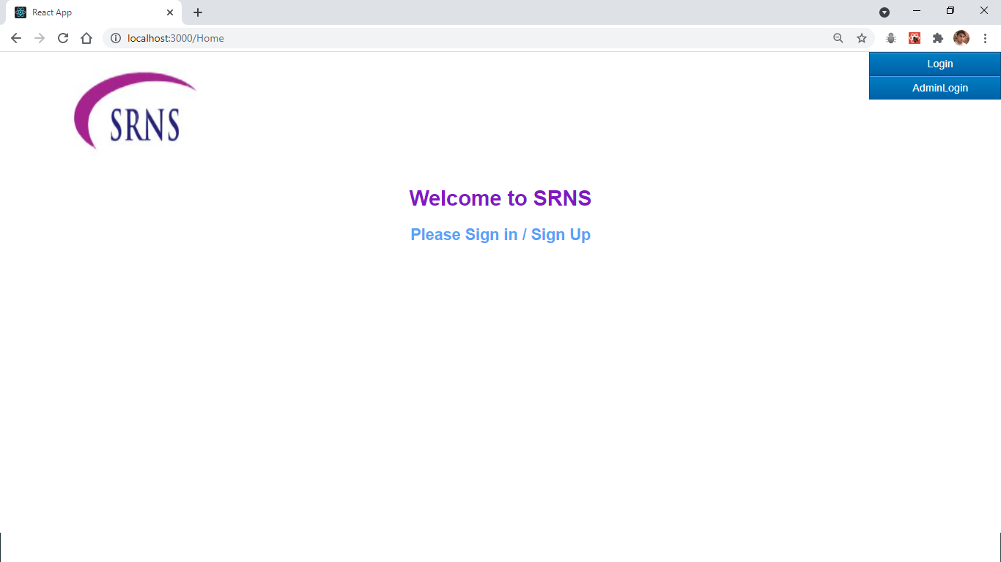
Demo

Slide 16

Thanks!
Any questions?

